Slide 1
A GLIMPSE INTO HOMOEOPATHY
Dr. C.K. Mohan, M.D. (Hom)
Professor & Chairman
Department of Paediatrics

Slide 2
Homoeopathy is
a specialised method of drug therapy
of curing natural diseases
by administration of drugs
which have been experimentally proved
to possess the power of producing
similar artificial symptoms
on healthy human beings.

Slide 3
Law of Similars Law of Single medicine Law of Minimum Dose Law of Drug Dynamisation Law of Individualization Law of Vital force
Basic Principles of Homoeopathy

Slide 4
Medicines are prepared
from natural resources
Vegetables
Animals
Metals & Minerals
Nosodes
Sarcodes
Imponderabilia

Slide 5
A German Physician 1755 – 1843

Slide 6
Scope of Homoeopathy
Homoeopathy has proved itself to be of great scope in treating all diseases, both acute and chronic.
It is also capable of effectively and efficaciously preventing and curing communicable and infectious diseases.
It can also successfully manage gynaecological and obstetrical cases.
It is also successful in the management of paediatric and geriatric ailments.

Slide 7
Scope of Homoeopathy (contd…..)
Almost all kinds of behavioural disorders, neurological problems, metabolic diseases are also within its effective curability.
Many surgical conditions relating to peptic ulcer, tonsillitis, goitre, kidney, urinary bladder, gall bladder, pancreas etc. can be safely dealt with through homoeopathic medicine.
Tendencies leading to surgical intervention can be well avoided if early diagnosis is made and prompt homoeopathic treatment is done.

Slide 8
Scope of Homoeopathy (contd…..)
Its role in primary health care is also highly rewarding, especially in a developing country like India.
Homoeopathy has a ready and effective answer to the menace of addiction to drugs, tobacco and alcohol and is highly efficacious in ridding the addicts of their craving for these noxious substances.
Efficacious in controlling and containing epidemics.

Slide 9
Present Status of Homoeopathy
Homoeopathy is currently prevailing in practice over eighty countries in the world.
The practice of homoeopathy is widespread in Europe, the United Kingdom, India, Pakistan, Sri Lanka, Malaysia, South Africa, Nigeria, Russian, South and North America, New Zealand and the South Pacific.
Homoeopathy has been integrated in to the National Health Care Systems of many countries including India, Mexico, Pakistan, Sri Lanka and United Kingdom.

Slide 10
The forward march of homoeopathy is steady and impressive. The World Health Organisation states that homoeopathy is the second most used medical system internationally.
Homoeopathy began in India by a group of missionaries who started practicing it in Kolkata.
Homoeopathy got recognition in 1937 when Mr. Ghias-ud-idin, moved a resolution in the legislative assembly.

Slide 11
Indian Parliament enacted the Homoeopathy Central Council Act in 1973.
Central Council of Homoeopathy (CCH)
a Statutory Body - the paramount authority to control and regulate the education
and practice of Homoeopathy in India
came in to existence in 1974.
In 1974 Homeopathy was included in the National Health Scheme along with Allopathy and Indian Systems of Medicine.

Slide 12
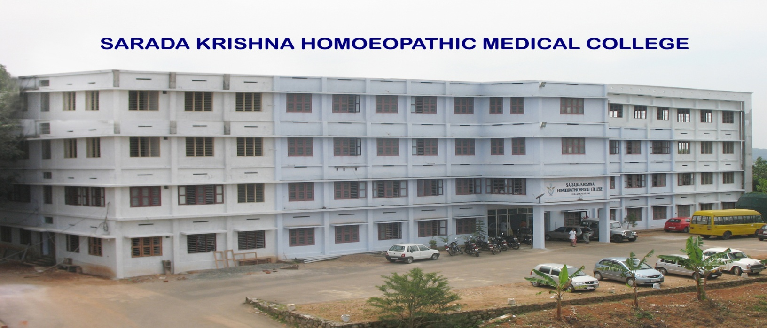
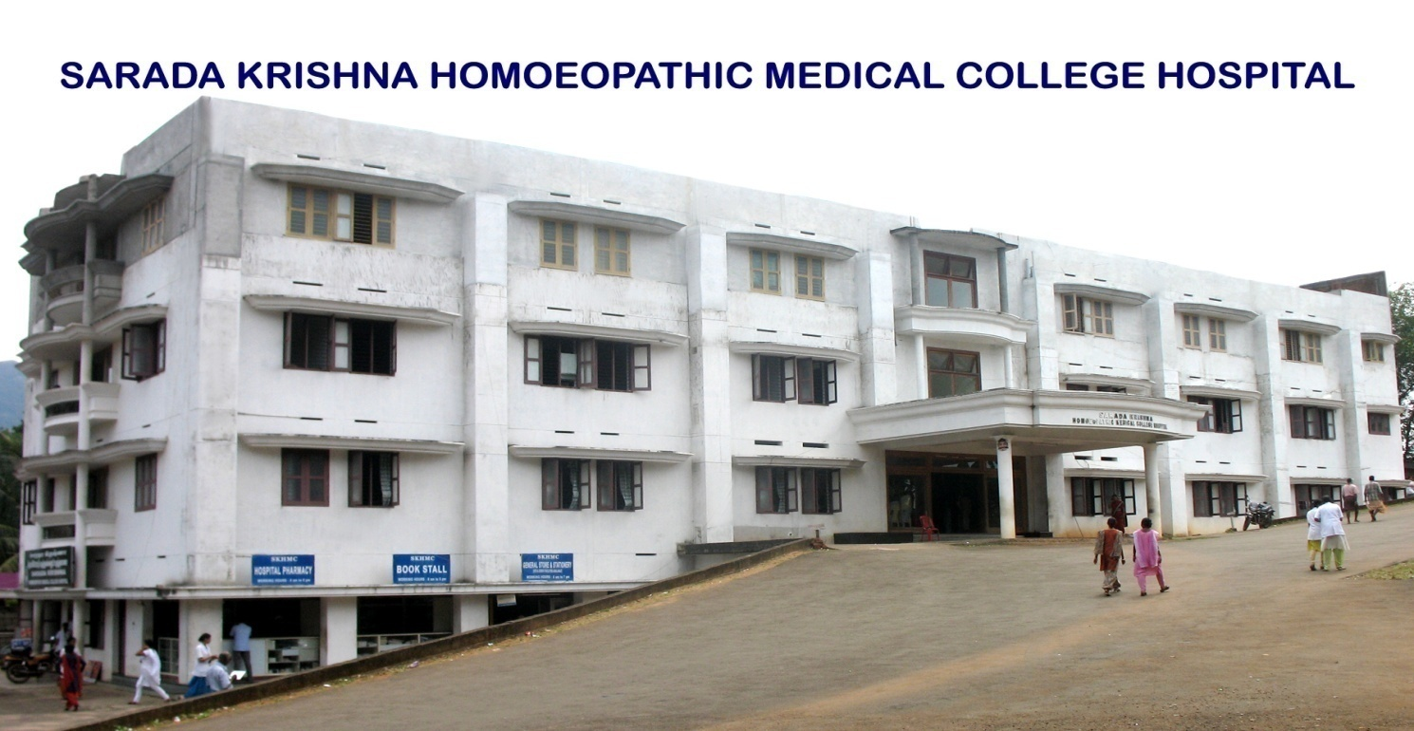

Slide 13
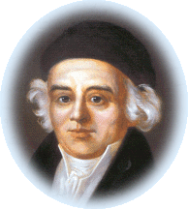
‘ REST !’ have I ever rested ? Forward, ever forward…………
- Dr. Samuel Hahnemann.

Slide 14
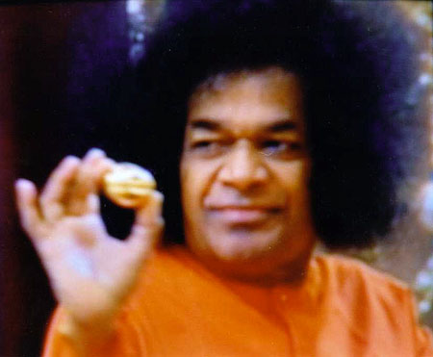
THANK YOU ALL

Slide 15
SCOPE OF HOMEOPATHY IN PAEDIATRICS

Slide 16
குழந்தைகளுக்கு எற்படும் நோய்களும்
ஹோமியோபதி மருத்துவமும்

Slide 17
சளி (அ) [yதோக்ஷம்

Slide 18
டான்சில் கட்டிகள்

Slide 19
(adenoids)

Slide 21
(Acute bronchitis):

Slide 22
Asthma:

Slide 23
Few other paediatric conditions
which can be managed with Homoeopathy
CHILDHOOD PROBLEMS RELATED TO LEARNING DISABILITY
SCHOLASTIC BACKWARDNESS AMONG CHILDREN
BEHAVIOURAL DISORDERS
MENTALLY CHALLENGED
THYROID DISORDERS
EATING DISORDERS
LOSS OF WEIGHT
SKIN DISEASES
PRIMARY COMPLEX
TUBERCULOSIS
LIVER DISORDERS
KIDNEY & URINARY TRACT DISORDERS

Slide 24
Few words about the institute I am working….
&
And its working plan…

Slide 26
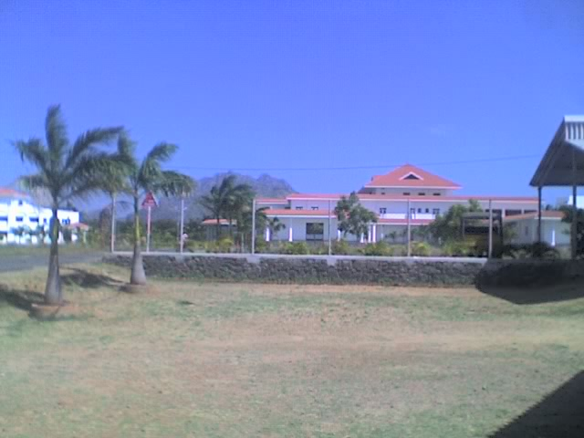
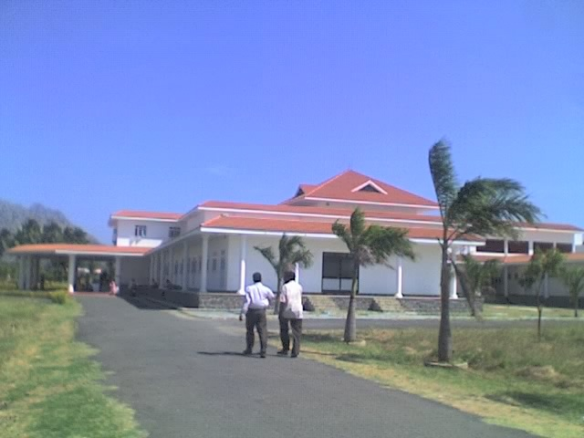
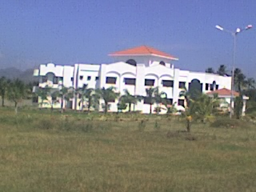
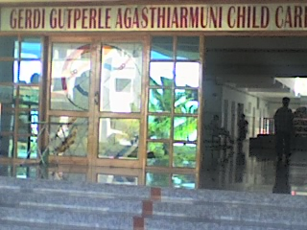
Gerdi Gutperle Agasthiarmuni Child Care Centre, Vellamadam, Nagercoil

Slide 27
‘ REST !’ have I ever rested ? Forward, ever forward…………
- Dr. Samuel Hahnemann.

Slide 28
THANK YOU ALL

